Slide 1
Innovation at every level - open innovation ecosystems
bror.salmelin@ec.europa.eu
Adviser, Innovation Systems, DG CONNECT
European Commission

Slide 2
Innovation?
Make things happen!
Science based linear innovation is NOT mainstream anymore!
User-centric innovation
Open innovation
Systemic innovation
Experimental mash-up
Leadership with courage -> new management skills
new pofessions

Slide 3
Diversity means breakthrough probability
high
Breakthrough
Value of innovation
average
insignificant
Low
High
Alignment of team members’ disciplines
low

Slide 4
New Business Structures
collaboration
process
process
Value Chain
Value Chain
mediation
Value Network
Value Network
Dynamic Value
Constellation

Slide 5
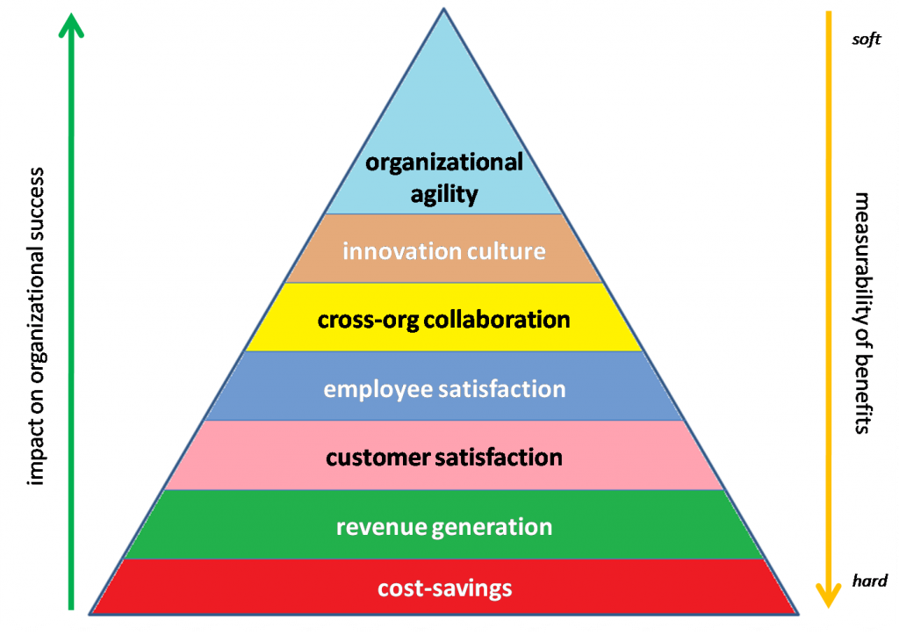
Maslow 2.0 for organisations

Slide 6
Essential drivers for modern innovation policy
connectivity
openness
interaction
“organic” (OrganiCsations..)
crowd resourcing
catalytic IPR
NON-controllable, only catalyzing possible

Slide 7
Innovation moving out of the Lab
Centralized inward looking innovation
Closed Innovation
Externally focused, collaborative innovation
Open Innovation
Ecosystem centric, cross-organizational innovation
Innovation Constellations
Sources: Chesbrough 2003, Forrester 2004, von Hippel 2005
Notes:
Definition and characteristics of networked innovation, examples per page or at the end of trends
Science and Engineering skills and external funding mechanisms are abundant
Innovations are valuable mostly as components on standard platforms used by many players.
Knowledge is shared with business partners

Slide 8


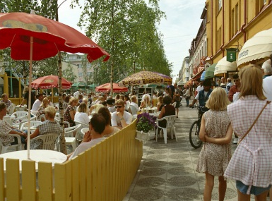
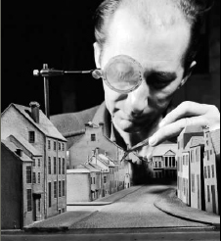

Innovating together in real world settings!
Open
Innovation 2.0
Citizens
and users
Expertise
Application
Environments
Organisation
and methods
Technology and
Infrastructure
Creative Commons; tools, IPR, practise, experience

Slide 9


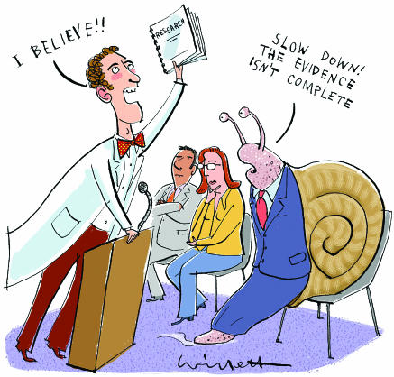
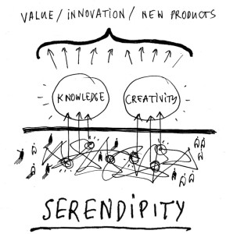

Open Innovation 2.0 key factors
Discovery Learning
Experimentation
Photo credits: www.respectserendipity.com
Embrace change
Evidence-based
policy-making
Orchestration

Slide 10
Paradigm change is REAL!
Closed innovation Open innovation Open innovation 2.0
Dependency Indepencency Interdependency
Subcontracting Cross-licensing Cross-fertilisation
Solo Cluster Ecosystem
Linear Linear, leaking Mash-up
Linear subcontracts Triple Helix Quadruple Helix
Planning Validation, pilots Experimentation
Control Management Orchestration
Win-lose game Win-win game Win more-Win more
Box thinking Out of the Box No Boxes!
Single entity Single Discipline Interdisciplinary
Value chain Value network Value constellation

Slide 11
Open Innovation 2.0
People | People, Community, Ecosystem centric. User, Citizen, Customer as innovator
Purpose | Shared Vision, Value and Values
Platform | Foundation for co-innovation, enable network effects
Patterns | Design for adoption, models for imitation Serendipity, Disruption
Partnering | Longer term win-win relationship based on shared risk and reward, Quadruple Helix
Prototyping | Rapid iteration and experimentation
Processes | Processes for innovation rather than ad-hoc. Bridging, Curating
People
Purpose
Patterns
Platform
Partnering
Prototyping
Processes

Slide 12
New innovation space
New professions: Curators and Bridgers] Orchestrators and System Designers
New types of ecosystems:
  Self directed
  Real world prototyping and experimentation
  Common interest
  Open platforms
  Recognition beyond ordinary means
Brings fast scale-ups

Slide 13
How to move forward
Platform economy?
-> innovation/engagement environments:
  Extremely distributed architectures emerging
  Functionalities combining technology drivers (5G, IoT, Blockchain, Cloud, Big/Small data etc)
  Open meta architecture
  Sociotechnological change: Unicorns are based on strong user-driven communities or user generated content -> power of crowds in business models? Trust? Sharing?

Slide 14
Summary
DO it! From Think-tanks to DO-tanks!!
Requires COURAGE to allow experiments, also evidence policy making based on real world experiments
Risk management, not avoidance
Creating new with the quadruple helix

Slide 15
Thank You!
https://ec.europa.eu/digital-single-market/en/policies/open-innovation
https://ec.europa.eu/digital-single-market/en/news/open-innovation-20-conference-2017
bror.salmelin@ec.europa.eu

