Slide 1
Investment Plan for Europe The European Fund for Strategic Investments – A financing option for Romanian businesses? Cluj, 31 May 2017 – Antonie Kerwien, EIB

Slide 2
Why an Investment Plan for Europe?
Investment & competitiveness gap
EU Investment Plan
EU and Member State policy action
EU budget guarantee
EIB capacity to mobilise additional investment
High liquidity in the market
Public budget constraints
Financial and non-financial barriers to investment

Slide 3
3 ways to tackle the investment gap
Investment Plan for Europe
Mobilise finance for investment
European Fund for Strategic Investments
Cooperation with National Promotional Banks
Give investment advice
European Investment Advisory Hub
European Investment Project Portal
Create an investment friendly environment
Improving the regulatory environment
Structural reforms
Aim: to mobilise at least €315 billion in investment across the EU

Slide 4
EFSI setup and governance
All EFSI operations are within the EIB Group (EIB&EIF)
On the EIB’s balance sheet (no separate entity)
Subject to standard due diligence
EIB & EIF governing bodies approve each operation
Additional EFSI governance:
Steering Board
Investment Committee, headed by a Managing Director
EIB
Group
EFSI

Slide 5
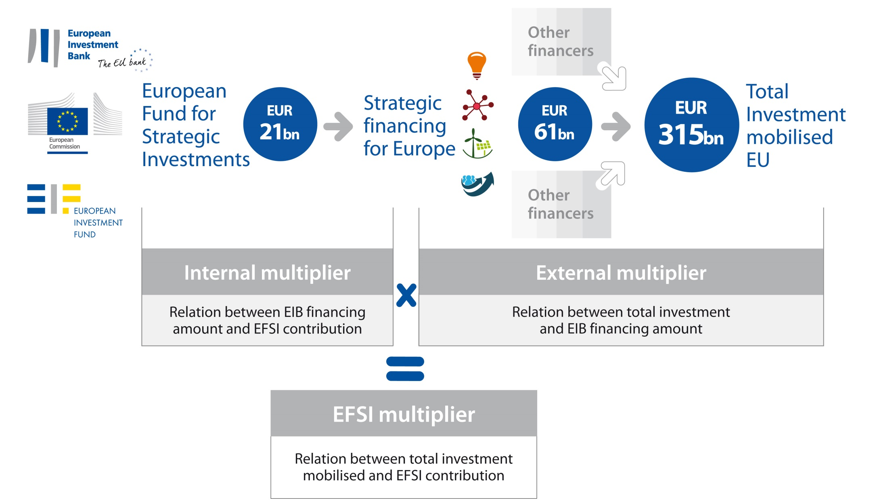
Mobilising new investment
Notes:
seed money is used to encourage private investment and other funding
multiplier = internal leverage (project signatures /consumed capital) + external leverage (total investment costs /project signatures)
multiplier on each project varies depending on
sector
geography
project setup and financing solution
inherent risk
average multiplier effect of 1:15 = prudent estimate
Past experience: capital increase 1:18, InnovFin around 1:16

Slide 6
Making a difference
Our value added
Addressing market failures or sub-optimal investment situations
Financing operations not possible to same extent otherwise
Absorbing part of the risk to trigger additional investments
Impact orientation
Attracting other sources of finance
Maximising growth
Supporting employment

Slide 7
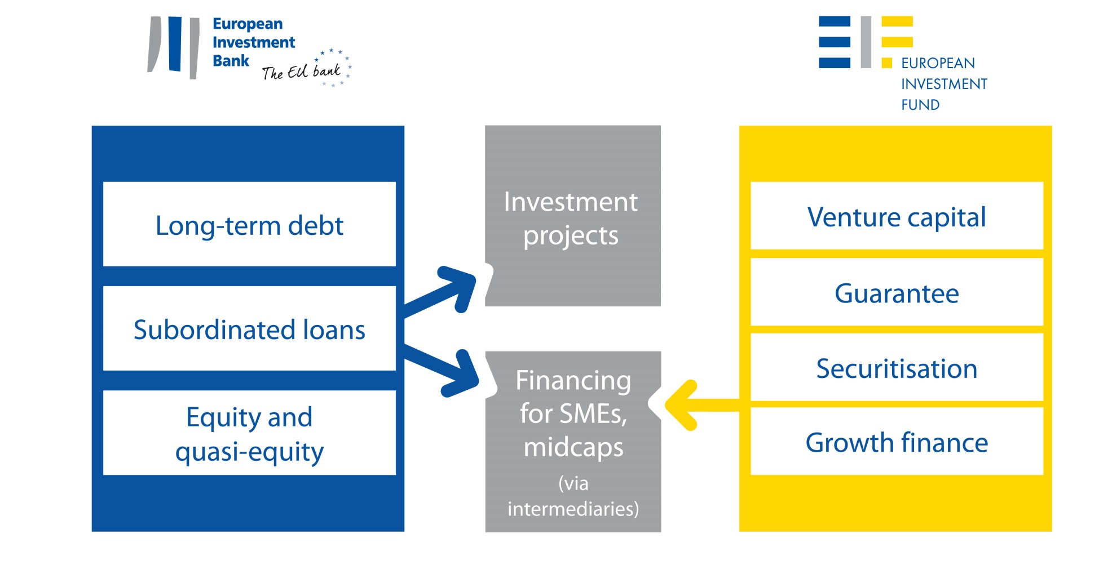
With targeted products
Continuously adapting to market needs

Slide 8
What are the loan amounts under EFSI?
According to EFSI regulation no specific minimum but lending practice at EIB Group requires best use of resources Indicative values for different financing operations
Long term unsecured loans:
from EUR 25m
Junior subordinated loans:
from EUR 12m
Mezzanine and equity products:
from EUR 7.5m
Intermediated EIB operations: various
EIF lending via financial intermediaries: up to EUR 7.5m*
*COSME programme: up to EUR 150,000
InnovFin initiative: up to EUR 7.5m

Slide 9
Key areas
Targeting strategic public and private investment
Infrastructure: including transport, energy and digital
Innovation: Education and training, health, research, development and innovation
Renewable energy: Expansion of renewable energy generation and support of energy and resource efficiency
Environment: Projects in the environmental, urban development and social fields
SMEs and midcaps: Financing support through local partner banks and institutions

Slide 10
Who can benefit?
Eligible counterparts
SMEs
(up to 250 employees) or midcaps
(up to 3 000)
Utilities and public sector entities
(non-sovereign)
Corporates of all sizes
Contact
EIB Group directly
via InfoDesk or relevant Operations Department
www.eib.org
www.eif.org
National Promotional Banks or other banks for intermediation
Dedicated Investment Platforms

Slide 11
What kind of operations?
Operations need to be:
Commercially sound, economically and technically viable
Underpin EFSI objectives
Support growth and jobs
Mature enough to be bankable
Priced in a manner commensurate with the risk taken
Covering EU28 countries or cross-border operations

Slide 12
Combining EFSI and other funding
EU Structural and Investment Fund programmes can contribute to the Investment Plan objectives and complement EFSI support
These may join EFSI-supported projects where this would ensure a higher value added
More information on the complementarity of structural funds and EFSI:
http://ec.europa.eu/regional_policy/sources/thefunds/fin_inst/pdf/efsi_esif_compl_en.pdf

Slide 13
SME financing under EFSI

Slide 15
EFSI in Romania
4 signed transactions
EFSI partners in Romania:
Direct EFSI support
+ Support for Agricover allows financial partner to increase its volume of affordable medium term loans to small and mid-sized agricultural businesses
+ Loan supports working capital, farm development and modernisation in rural areas
COSME Loan Guarantee Facility
+ Backs loans for potentially 2000 small and medium companies and start-ups which have a limited access to lending
+ Borrowers will benefit from reduced collateral requirements and extended maturities
+ EUR 150.000 max amount
InnovFin SME Guarantee Facility
+ Guarantees to financial intermediaries to help them to provide loans and leases to research-based and innovative smaller and medium companies (up to 499 employees)
+ Financing amounts between EUR 25 000 and EUR 7.5 million
Notes:
COSME - Loan Guarantee Facility (LGF)
http://www.eif.org/what_we_do/guarantees/single_eu_debt_instrument/cosme-loan-facility-growth/index.htm
Raiffeisen Bank Romania S.A., https://www.raiffeisen.ro/
InnovFin SME Guarantee Facility
http://www.eif.org/what_we_do/guarantees/single_eu_debt_instrument/innovfin-guarantee-facility/index.htm?lang=-en
Procredit Bank Romania http://www.procreditbank.ro
UniCredit Bank S.A., http://www.unicredit.ro/en/persoane-fizice.html

Slide 16
What is the Advisory Hub?
A joint initiative by the European Commission and the European Investment Bank
A tool to strengthen Europe's investment and business environment
A single access point to a 360 degree offer of advisory and technical assistance services
A cooperation platform to leverage, exchange and disseminate expertise
An instrument to assess and address unmet needs for advisory support
17

Slide 17
A 360 degrees advisory offer
TYPE OF SUPPORT
DESCRIPTION
PROGRAMMES
Support for projects and investments
Advisory and technical support in identification, prioritisation, preparation, structuring and implementation of investment projects
JASPERS, ELENA, EPEC, Implementation support programmes
Enhance use of EU funds
Advisory and capacity building support in the implementation of ESIF financial instruments
fi-compass, bilateral services to Managing Authorities
Access to finance
Enhancement of the overall conditions for financing for public and private beneficiaries
Innovation Finance Advisory
Access to the expertise of the Hub’s local partners
Advisory and technical support from the Hub’s local network
Access to new advisory services
Continuous development of the Hub’s advisory offer to address unmet needs
19

Slide 18
Financing unique projects

Slide 19
Creta Farms Unique Mediterranean diet technology, Greece
EFSI Financing amount:
15m
EFSI related investment:
31m
Financing backs:
- Research and development of cutting-edge diet technology and growth in overseas markets
New EIB client
First EFSI operation in Greece
Client developed proprietary “oliving“ technology, which replaces fat from meat and dairy with olive oil
Notes:
17 patents worldwide since 2001
5 times the average RDI spending of its peers in the food sector
first EFSI operation in Greece. Provides an example of European financing of a Greek company and potentially shows the way to other international banks in stepping back into the Greek market.
Biggest player in the Greek cold-cuts market
Greece level of R&D expenditure (0.7% of GDP) is significantly below the EU average of 2.0% of GDP. This transaction finances a major Greek company which has constantly been contributing to Greek employment despite the difficult economic environment in the country.
Its new strategy targets international growth opportunities from direct exports and licensing agreements in overseas markets.

Slide 20
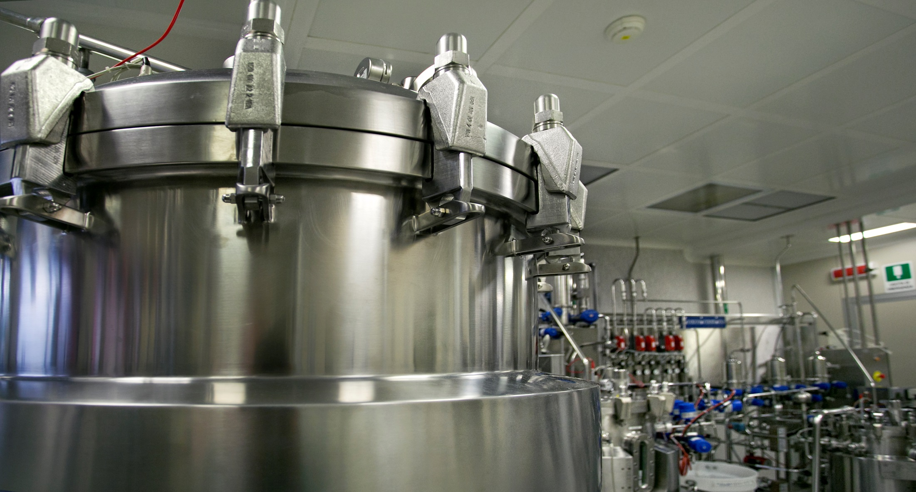
Novamont World leader in biodegradable plastics, Italy
EFSI Financing amount:
15m
EFSI related investment:
93m
Financing backs:
- Development of integrated supply chain
- Industrial production of bioplastics and chemicals
- Research that will help to create growth and jobs ( e.g. biotechnology)
EFSI allows to support the client in a new, small and fast growing market
Client developed concept of bio refineries in abandoned industrial sites
Notes:
Novamont is a world leader in the sector of bioplastics
concept of a biorefinery: fully integrated with the local agricultural supply chain and dedicated primarily to the production of bioplastics and chemicals from renewable biomass resources.

Slide 21
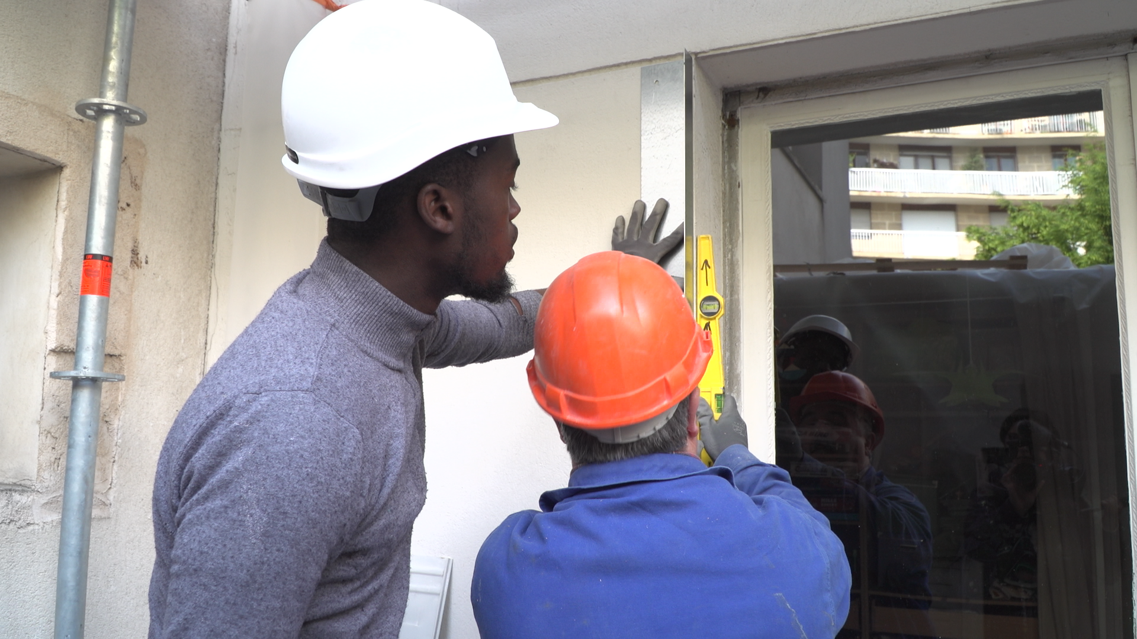
SEM Energies POSIT-IF Ile de France Energy efficiency refurbishment in residential buildings, France
EFSI Financing amount:
100m
EFSI related investment:
200m
Financing backs:
- Energy efficient refurbishment in residential buildings (ca 75% of the buildings are condominiums or social housing apartments)
- 50 to 75 % reduction of overall energy consumption of the buildings
Market failure between what commercial banks offer and what individual owners required.
EFSI allowed the semi-public company Energies POSIT’IF to offer financing directly to the owners.
Notes:
In the Ile-de-France region (most populated region in France with 12 million inhabitants) people live mainly in joint ownership residential and social housing buildings. Hence, the region has developed a dedicated company to support and finance energy efficiency retrofit in these buildings: the SEM Energies POSIT'IF.
SEM are sociétés anonymes (SA) created by local authorities with a mix of public and private shareholders. SEM can run any services of general interest, including commercial activities. Local authorities can give mandates to SEM through regular procurement procedure.
The Bank has no history of lending to SEM, however there are over one thousand SEM and other EPL in France with a combined turnover of 12 billion euros and over 52,000 direct jobs (source: Fédération des EPL). In the area of urban renewal, EPL are the most frequent type of vehicle used by local authorities. The Bank has nevertheless a history of lending operations with several of the shareholders of the Borrower.

Slide 22
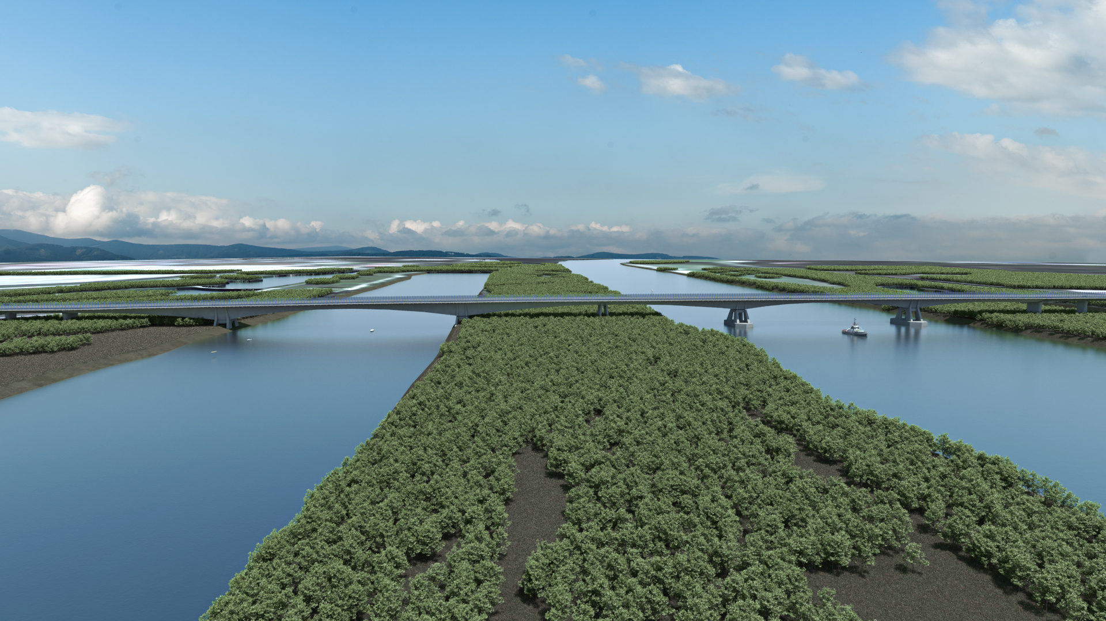
Motorway D4 Design and Construction, Slovakia
EFSI Financing amount:
426m
EFSI related investment:
636m
Loan tenor: more than 30 years
Successful combination of EU structural funds and EFSI.
One of the first of its kind to finance a large scale PPP project via the combination of different EU sources.
Consultation with the EIB enabled the Public Sector to technically optimise the project scope and to achieve a substantial reduction in project cost.

Slide 23
Taking more risk in a project

Slide 24
Skeleton Delivering a better way to store energy
Financing backs:
- R&D in revolutionary energy storing technology
- Development and production of ultracapacitors (devices that are used when energy is needed in great, short busts) with 4 times the power density of those produced in the traditional way
EFSI enables:
- Quasi-equity financing, allowing for performance-based remuneration instead of a steady repayment flow – crucial for a young company that needs to invest in research to maintain its position in the world market
EFSI Financing amount:
15m
EFSI related investment:
32m

Slide 25
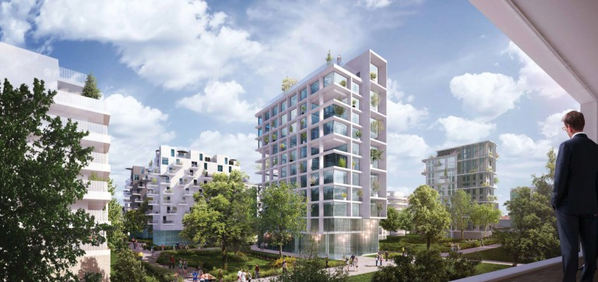
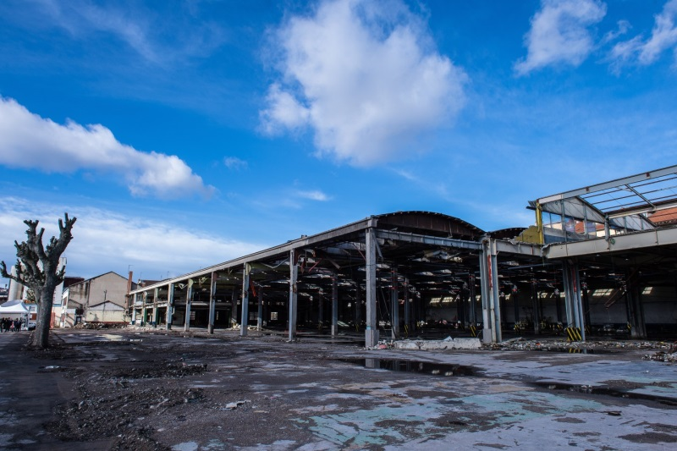
Ginkgo II Land decontamination Fund, France and Belgium
EFSI Financing amount:
30m
EFSI related investment:
not disclosed
Equity type
Financing backs:
- State-of-the-art environmental techniques to clean toxic soil of old industrial sites in urban regions
- Construction of new apartments and affordable housing
EFSI allows faster and larger set-up of the fund
Contaminated sites can not be used as security
Notes:
Ginkgo Fund II (the “Fund”): EUR 120m private equity fund)
Complex financing structures and associated risks require equity investments for the land remediation.
The operation benefits from the EU guarantee in accordance with the EFSI Regulation and the terms of the EFSI Agreement given:
i) the Fund’s focus on an EFSI priority sectors (environment and resource efficiency);
ii) its clear intention to crowd-in institutional investors that have not invested in this sector or the predecessor fund and are anticipated to account for more than 50% of the Fund’s commitments. An EIB investment might have important signaling effect for private sector investors; and
Ginkgo I related:
For a full investment in a follow-on fund, the Bank would normally require that the predecessor fund is fully committed and has successfully exited its investment. The additionality for the envisaged EFSI support stems from the fact that the Bank would have proposed a significant smaller investment into the Fund in absence of EFSI given the associated risks and the lack of a full track record as the predecessor fund has been almost fully committed but no full exit has been achieved yet.
EIB has invested EUR 15m in Gingko I, the FM’s predecessor fund (Size EUR 80m and Serapis no: 2008-0189). Ginkgo I has completed its investment period in December 2015 and it has already committed circa 98% of its investable capital in seven projects. Ginkgo I is performing in line with expectations (IRR 7.82%) and the first partial exits (two investments) are underway (expected to achieve net IRR of circa 13%).
The involvement of the EIB was key to convincing other investors to put their money into the first Ginkgo fund. The Fund manager, Bruno Farber, expects the same to be true for Ginkgo II. “The EIB’s role must be stressed,” he says. “As a cornerstone investor, the EIB’s presence showed other institutions that real, in-depth due diligence had been carried out, and that the predecessor fund had been well managed in a challenging economic context.” > EIB endorsement is important factor for their investment decision.

Slide 26
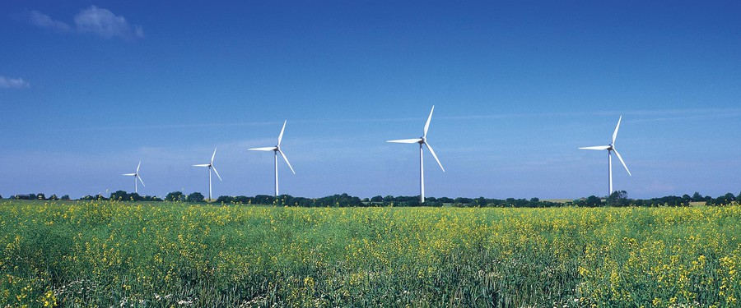
Energiepark Bruck Construction and operation of onshore wind-farms, Austria
Financing backs:
- Construction and operation of two wind parks and a single wind turbine (total capacity of 39 MW)
- EU and national targets for renewable energy generation
EFSI allows riskier lending to a shareholder, composed of a large group of small private investors and local farmers.
Higher leverage than previously accepted by the EIB in onshore wind projects.
EFSI Financing amount:
40m
EFSI related investment:
65m
Notes:
Strong EIB commitment to fund a large share of the expansion of Bruck without a third-party guarantee accelerated the financing.
The Bruck expansion is highly leveraged in comparison to standard non-recourse projects, because it is largely financed by external debt. (The envisaged project structure with the use of EFSI support will allow for a higher leverage (13% equity / 87% debt) than previously accepted by the Bank in onshore wind projects.
In addition the shareholders consisting of a large group of small private investors including local farmers with poor financial resources if compared to any strategic or financial investor represent a higher risk during the construction period and in case of cost overruns.

Slide 27
Supporting a higher number of projects in one risk group than otherwise possible

Slide 28
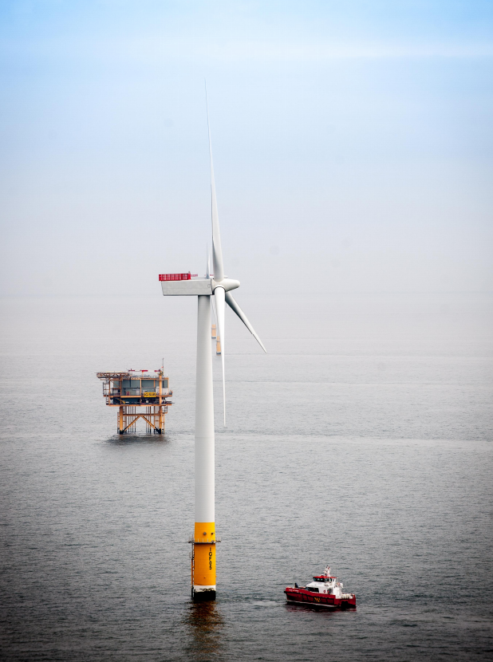
Beatrice Offshore Next-Generation Turbines for Offshore Wind Farm, UK
Offshore technology and market still at early stage
Size of the wind farm leads to technical and financial complexity
EFSI allowed EIB single largest investment in offshore wind farm
EU guarantee essential to further develop and deploy offshore technology
475,000 households benefit
EFSI Financing amount:
292m
EFSI related investment: 2,5bn
Loan tenor: 19 years
Notes:
The offshore wind industry could easily have wiped out in 2008, when the global financial crisis made investors especially leery of risk. Though onshore wind farms were relatively well-developed, offshore technology was still in its early stages.
“Commercial banks were very reluctant to take the risk,” says Peter Jacobs, head of the EIB’s Western Europe project finance division. “This industry wouldn’t have started moving without the presence of the EIB.”
Private investors put off back by: high investment and operational costs extreme weather and environment costly logistics.
84 Siemens SWT 7.0-154 Trubines
33kV Offshore-Converter; 65 km cable

Slide 29
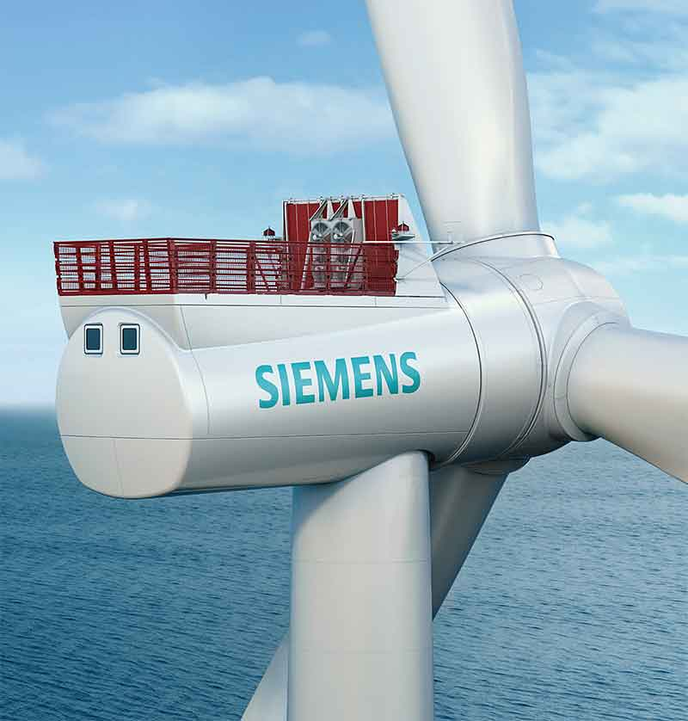
Rentel Offshore Wind Next-Generation Turbines for Offshore Wind Farm, Belgium
Offshore technology and market still at early stage
Use of novel turbines creates higher risks to the project
EU guarantee essential to further develop and deploy offshore technology
219,000 households benefit
EFSI Financing amount:
250m
EFSI related investment:
1115m
Loan tenor: 20 years
Notes:
Offshore wind remains a relatively young renewable energy technology sector and is at the higher end of what constitutes an acceptable risk for any project finance bank.
The project involves the design, construction, operation and maintenance of an offshore wind farm of 294 MW, located in the North Sea, 42 km from Ostend harbour, in the Exclusive Economic Zone (EEZ) of Belgium
It will become one of the largest offshore wind farms in Belgian territorial waters with a capacity of 294 MW, roughly equivalent to the energy consumption of around 219.000 households. The windfarm will be located some 32 km off the coast of Belgium, between the currently operational C-Power and Northwind projects, which have also been supported by the EIB. The project will employ a new, larger turbine model built by Siemens.
After reaching its financial close, offshore construction is set to begin in the second quarter of 2017.
With some EUR 250 million of the EIB investment in the project provided under EFSI, Rentel would match last year’s “Nobelwind” project as the largest project in Belgium under the “Investment Plan for Europe” to date. The development of offshore wind energy will support EU and national targets for renewable energy generation and contribute to security of energy supply and environmental objectives.

Slide 30
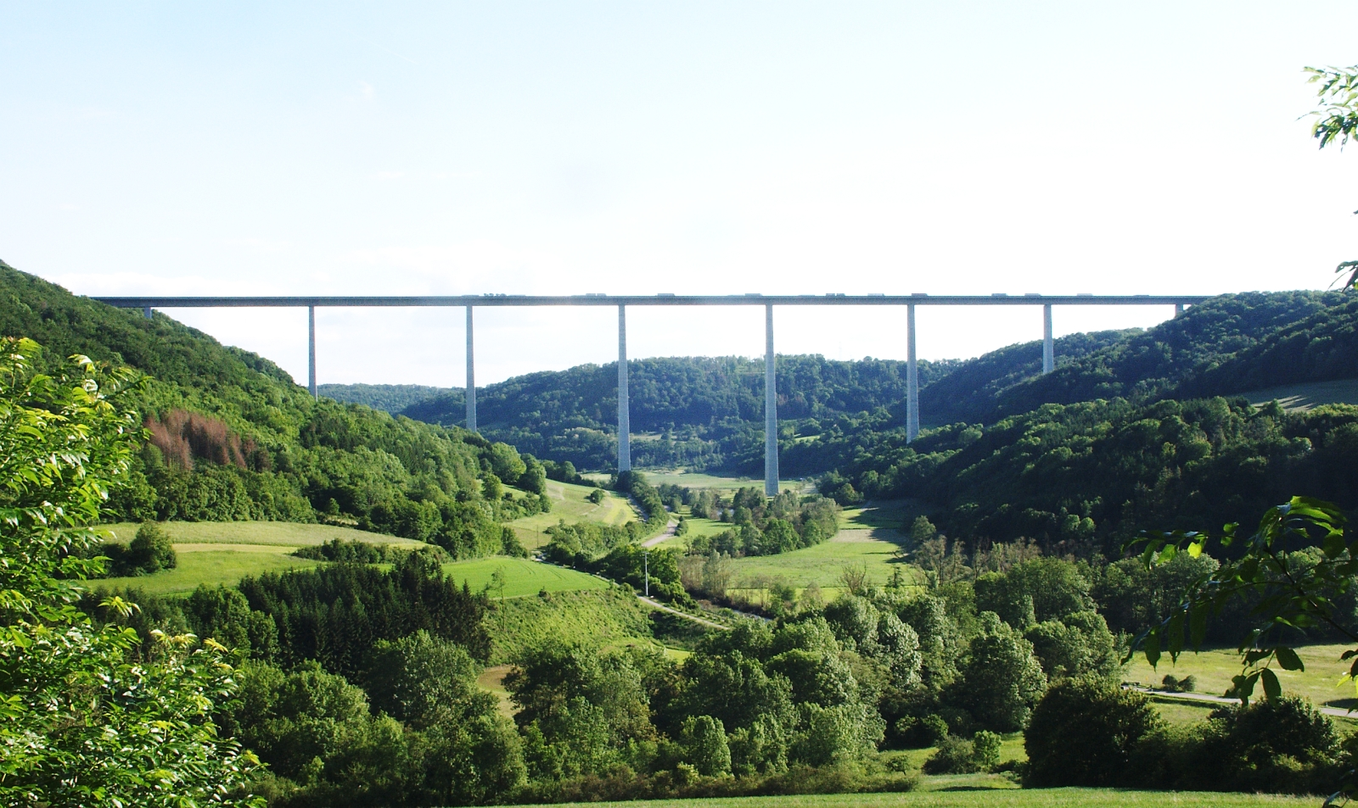
Motorway A6 Modernisation and Widening, Germany
EFSI Financing amount:
250m
EFSI related investment:
not disclosed
Loan tenor: 29 years
Part of largest single investment program for transport infrastructure in Europe (TEN T)
Project entails difficult construction conditions (e.g. ongoing traffic/ special constructions)
EFSI allows EIB to invest, even though concentration risk limit for comparable projects is used up
Notes:
widening from four to six lanes of 25.5 km of the A6 motorway between junctions AS Wiesloch/Rauenberg and AK Weinsberg, under a 30-years PPP – DBFO concession.
replacement of a 1.3 km long viaduct which crosses the Neckar Valley and the operation and maintenance of 47.1 km of road
the new 1350m long viaduct over river Neckar, to be constructed on temporary supports and moved horizontally by 15-20 meters into its final position.
construction period of 5 years = longer than usual

Slide 31
Timeline and investment period
2015
2016
2017
2018
2019
2020
4 July
4 July
4 July
30 June
Entry into force of EFSI Regulation
Third anniversary of signing the EFSI Regulation
1st deadline for signature of EFSI operations
Deadline for approval of EFSI Operations
2nd deadline for signature of EFSI Operations
Investment period to achieve EUR 315bn of total investments
“Extended” investment period
EFSI operations to target EUR 315bn of total investment by 2018
Actual investment period runs until 30 June 2020
27

Slide 32
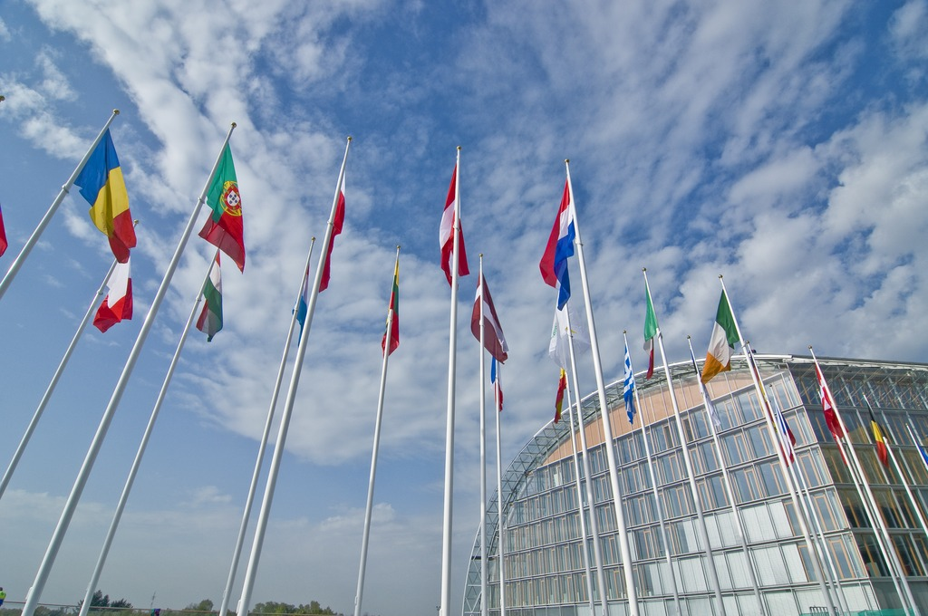
Thank you!

Slide 33
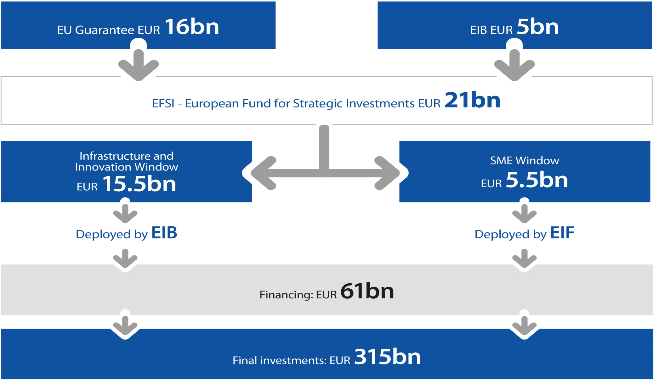
Mobilising new investment

